Slide 1
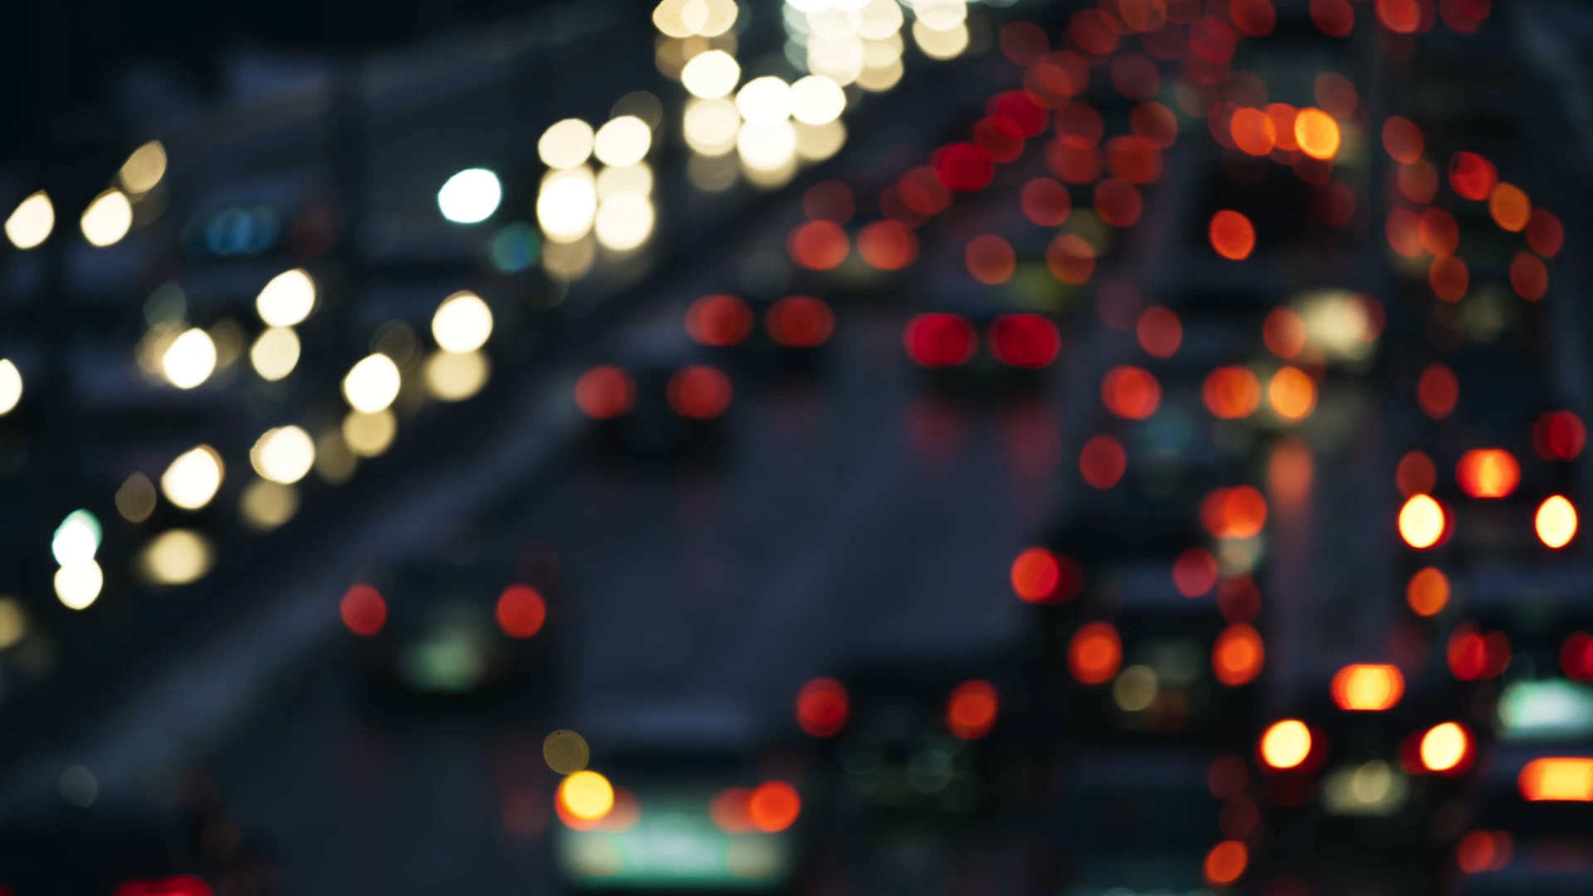
Traffic Lights Project
Team 6
Digital Systems

Slide 2

The situation
Side Road
SR
HG
HG
SR

Slide 3
Understanding the problem
A Busy Road Crosses Paths With This Hardly-ever-used Side Road, And Those Detectors (C) Pick Up On Any Cars Cruising Down That Country Lane
If there's no car on the Side Road, the lights stay green for the traffic heading towards the highway
When there's a vehicle on the farm road, the lights on the highway change from green to yellow to red, giving the green light to the farm road.

Slide 4
Inputs
Sensor (C)
Clock (50 MHz)
Reset Signal

Slide 5
Outputs
Light_highway [2:0]
Light_SR [2:0]

Slide 6
Building the state machine
There are 4 states:
Highway Green and Side Road red.
Highway Yellow and Side Road Green.
Highway Red and Side Road Green.
Highway Red and Side Road Yellow
And transtitions depends up on three variables
A timer
Reset Signal
Sensor Signal

Slide 7
C
~Delay3s1/ C/~rst
HGRE_SRED
HYEL_SRED
rst
~C
IDLE
rst
Delay3s1/ C/~rst
delay3s2/ C/~rst
rst
rst
HRED_SYEL
HRED_SGRE
delay10s/ C/~rst
~delay10s/ C/~rst
~delay3s2/ C/~rst

Slide 8

Verilog Code

Slide 9
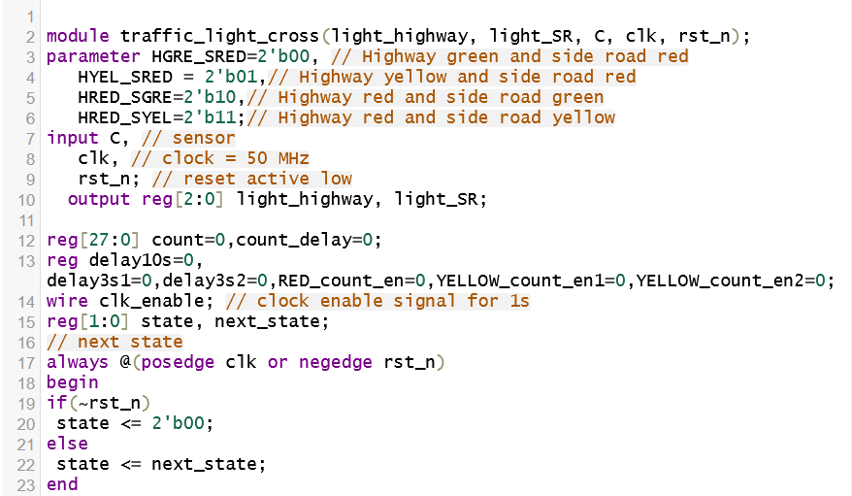

Slide 10
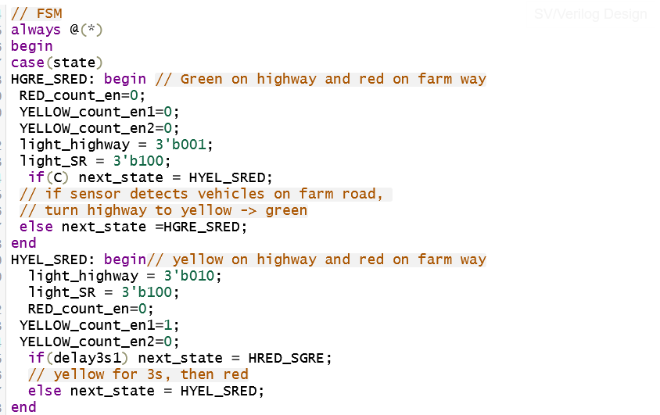

Slide 11
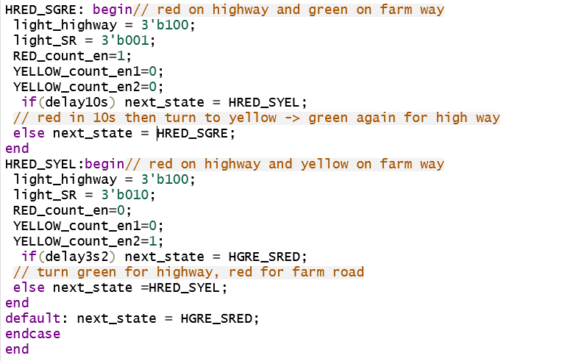

Slide 12
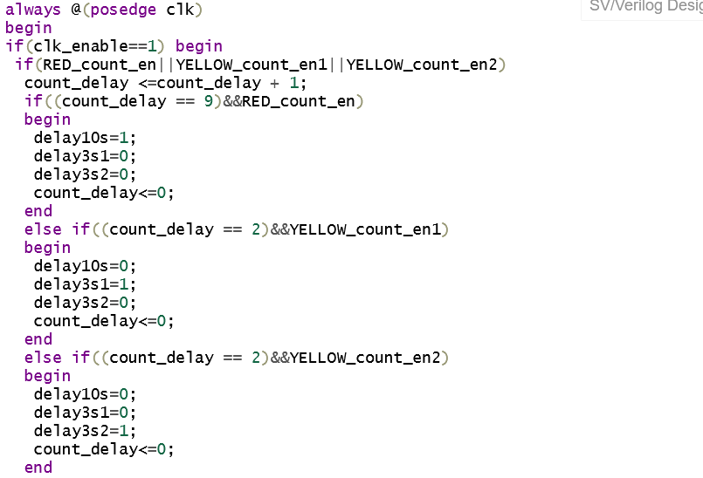

Slide 13
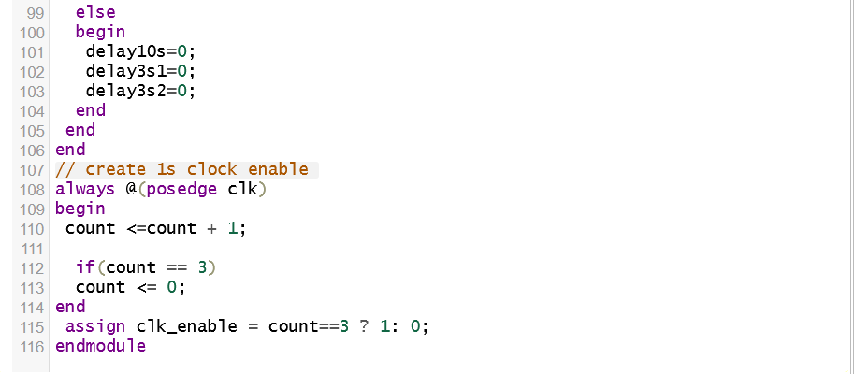

Slide 14


TestBench Code

Slide 15
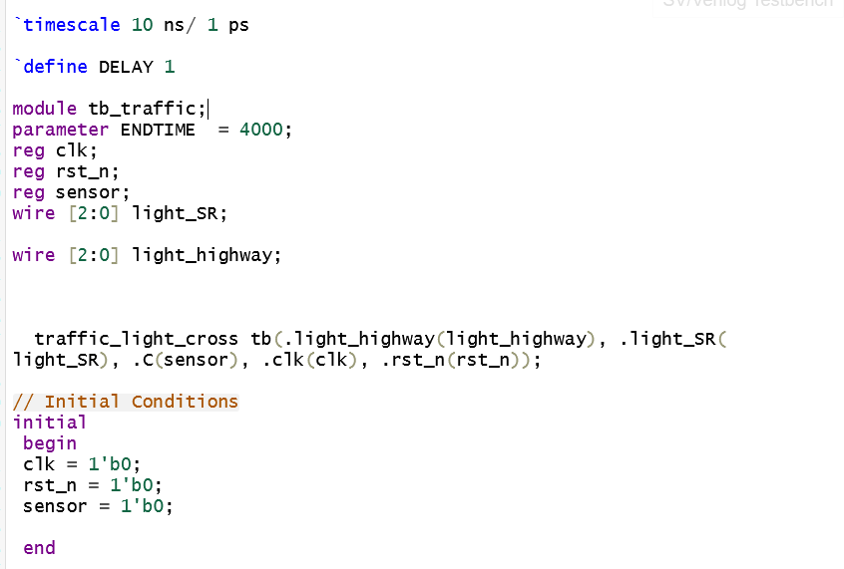

Slide 16
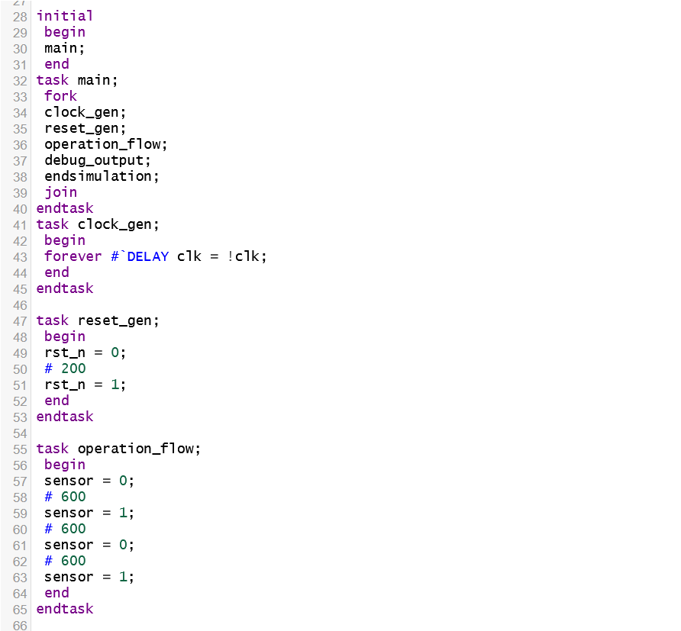

Slide 17
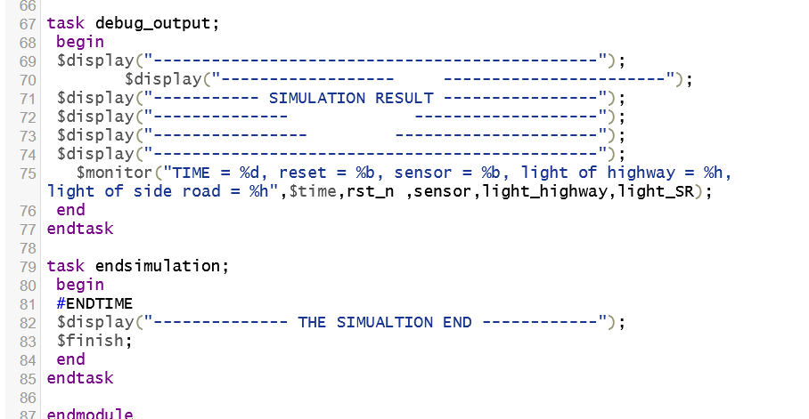

Slide 18
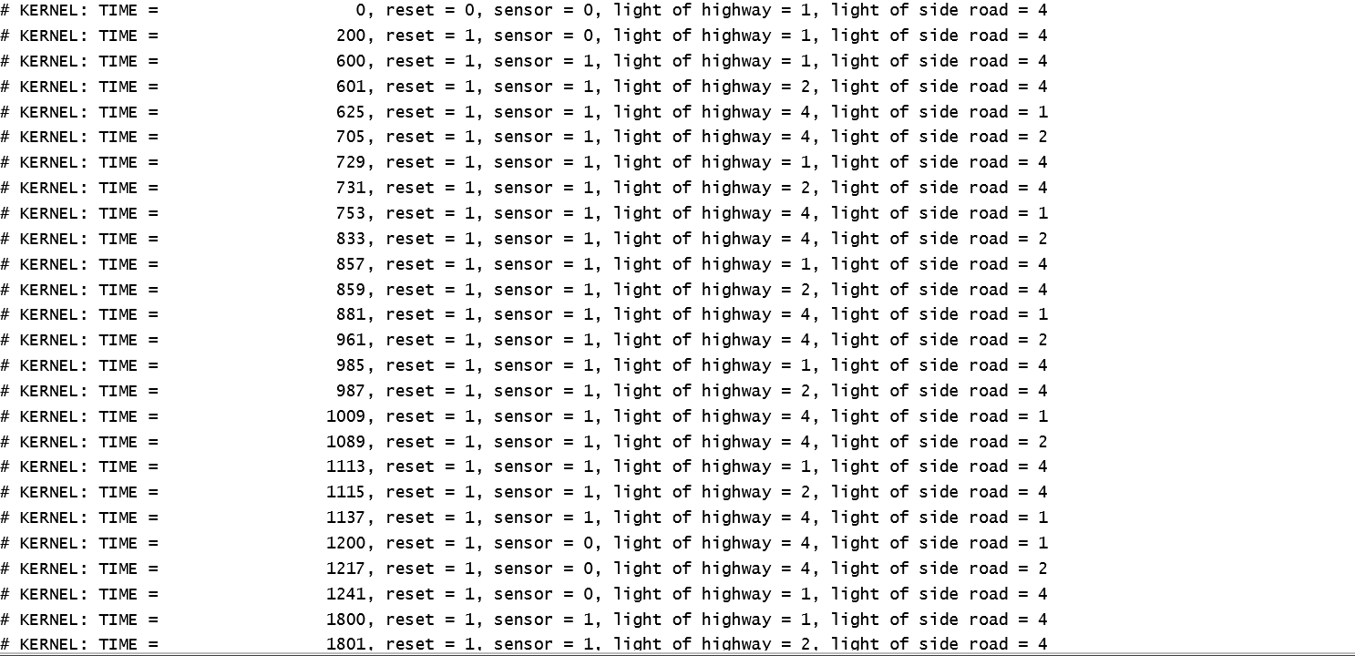
Simulation Results

Slide 19
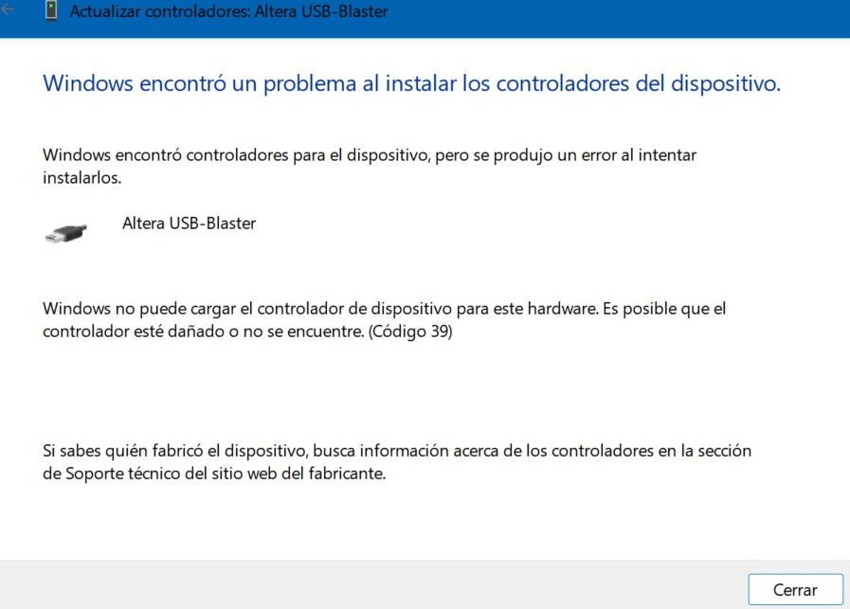
And the FPGA Implementation
Well…..

Slide 20

Then, We’ll tray on Chava’s computer today, please do not send us to the final exam.

